Slide 1
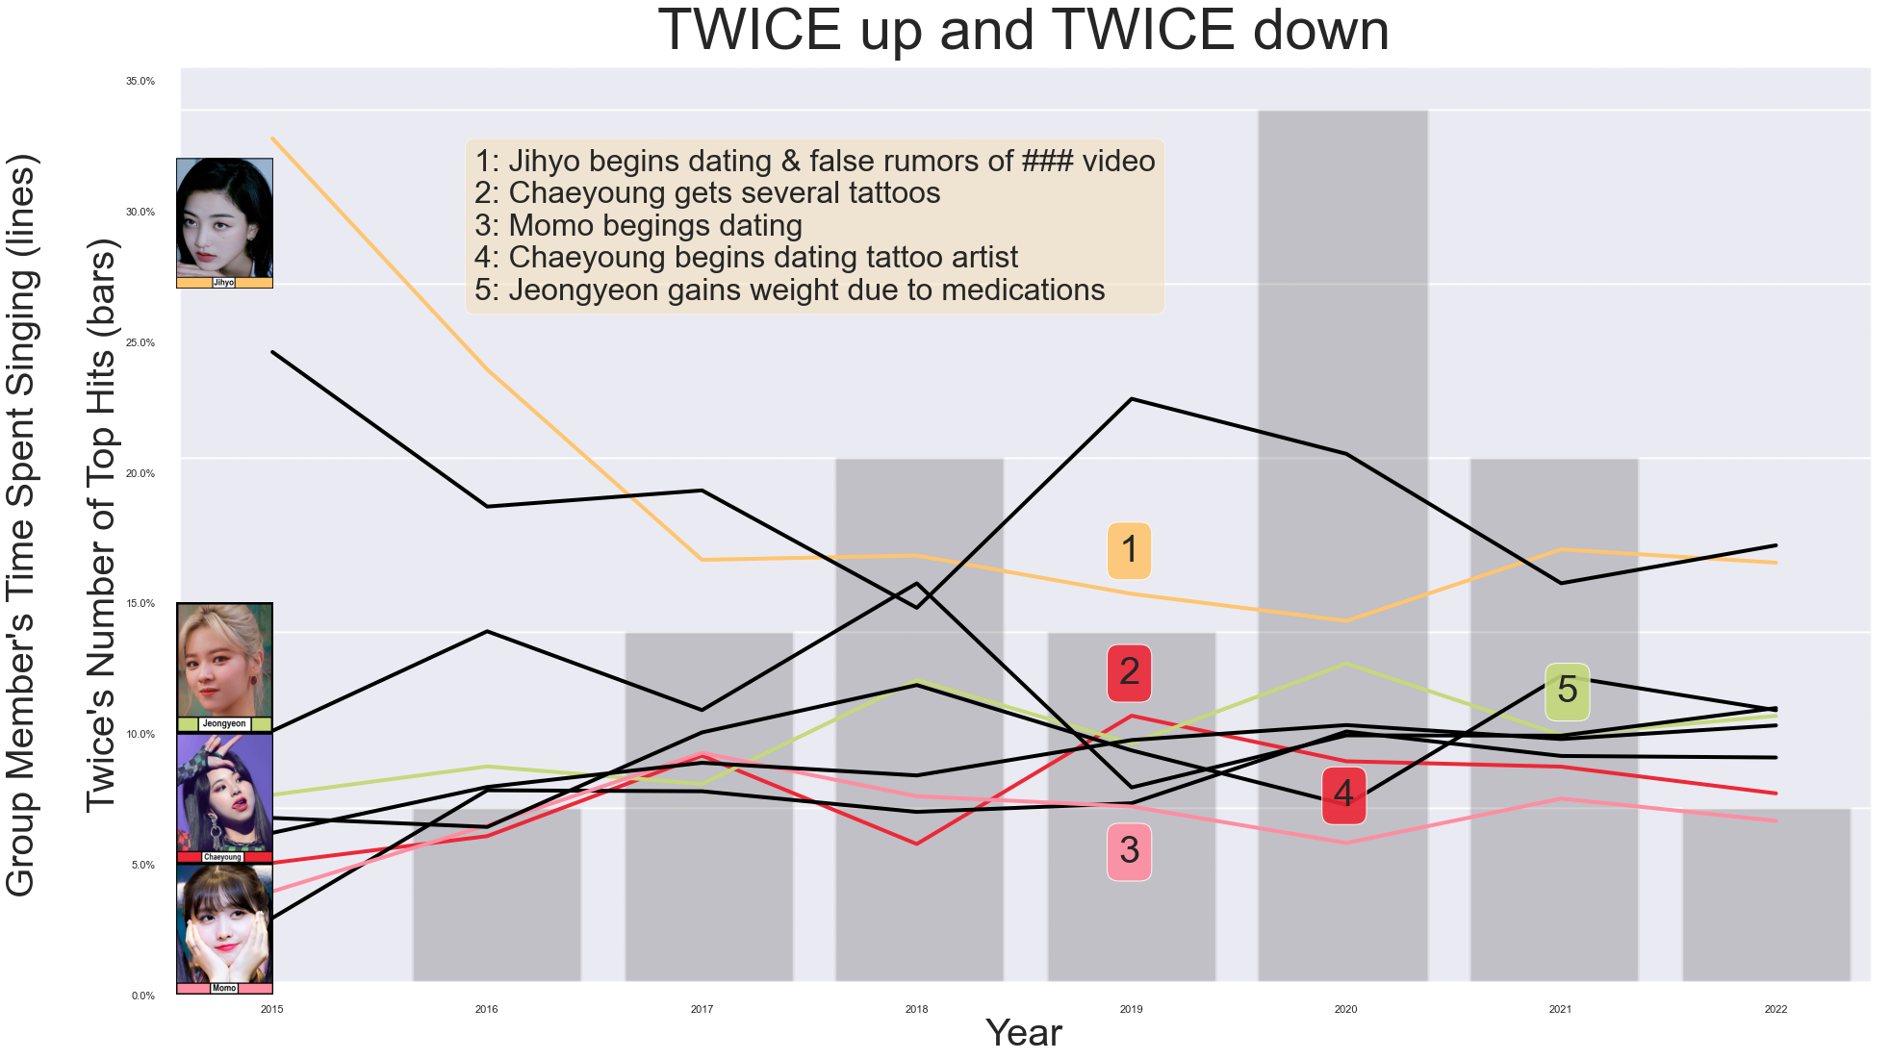

TWICE UP AND TWICE DOWN
Debuted with two-superstars
No one has received stable line distributions – changes occur
2018-2019: the most noticeable changes with line distributions and the group’s hits frequency in the chart
Datasets:
Peralta, JC. (August, 2022). TWICE Korean singles lyrics. Kaggle. https://www.kaggle.com/datasets/jcacperalta/twice-korean-singles-lines
Berjamin, Sandra Angela. (February, 2022). K-Pop Hits Through The Years. Kaggle. https://www.kaggle.com/datasets/sberj127/kpop-hits-through-the-years
Apple Music. (2022). Top 100: South Korea. Apple Music.
Spotify. (2022). K-POP ON!. Spotify.

Slide 2
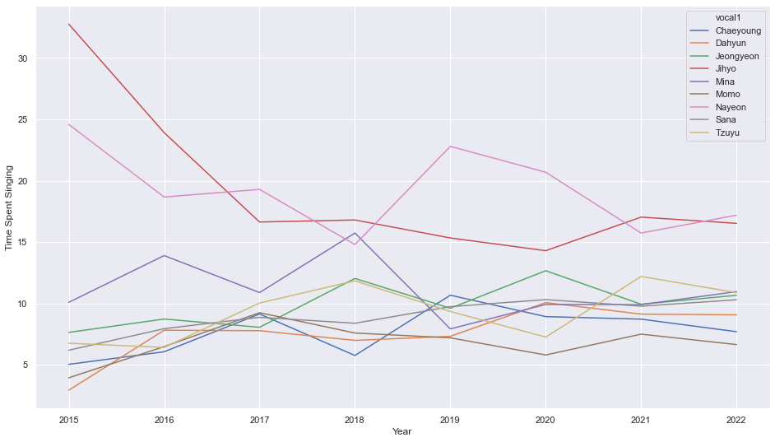
Methods and Findings
Methods
Significances
Manipulating Dataset
Groupby, Fraction (%), Dictionary
Line Plot and Bar Chart
Sns.lineplot, plt.subplots, sns.barplot, overlay
Each line is color-coded by each member’s official color
K-pop industry
K-pop idol groups with many members
Unfair distribution of screen time/line distribution
Line distribution = popularity, Public opinion
Scandalous events are negatively associated with popularity
Tattoo
Dating
Gaining weight

